Slide 1
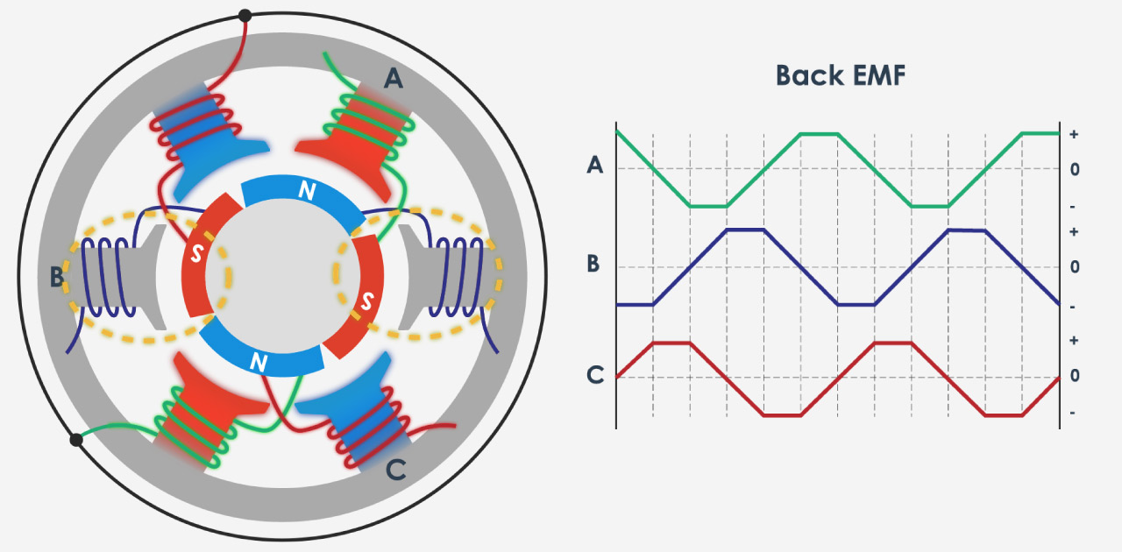
ATmega328 based robust Electronics speed controller for BLDC motors
Designed and being developed by THIRUVARULSELVAN K
Sophomore – ECE
BIT - Sathy

Slide 2

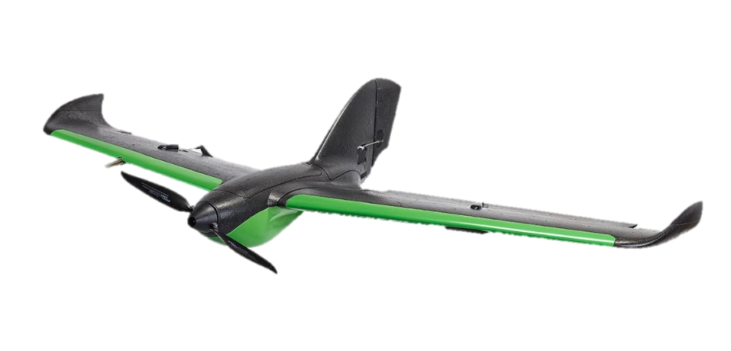

Applications of bldc esc
It is used for controlling BLDC motors used in various applications,
Multi-rotors
Multi-rotors
Fixed wing aircrafts
Electric vehicles

Slide 3
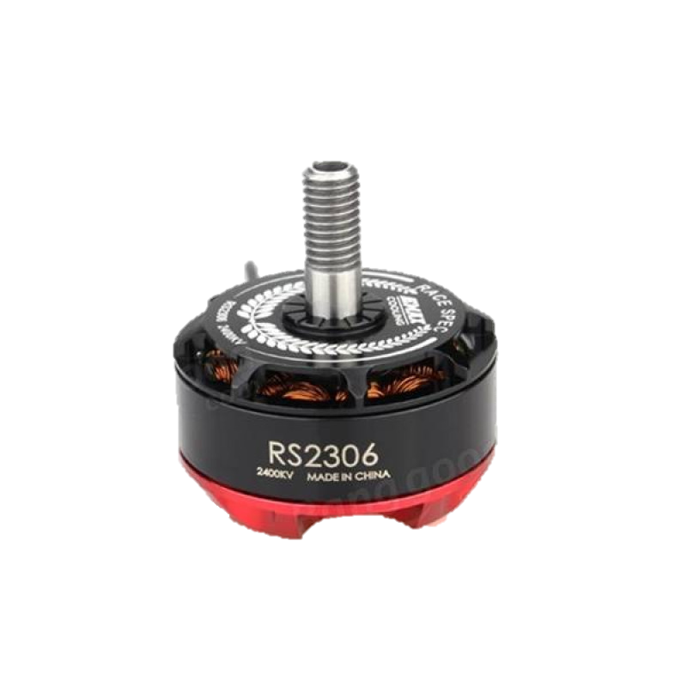
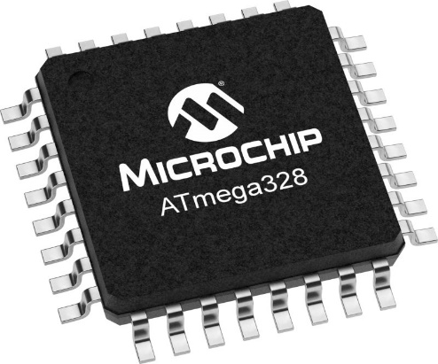
My design and working
3 Phase Bridge
Feed Back Circuit

Slide 4
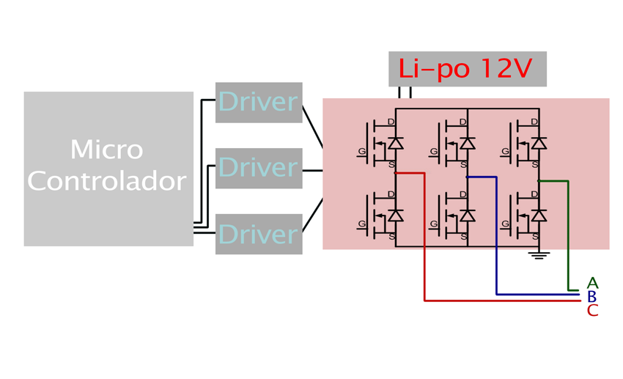

Slide 5
Specifications of my esc
Parameters | Values
Operating voltage (V) | 7.4 – 14.8 Volts
Constant current (A) | 30 A
Burst current (A) | 50 A – 10 seconds
BEC output | 5V, 1A
Max Speed | 2 Pole: 210,000rpm 6 Pole: 70,000rpm 12 Pole: 35,000rpm

Slide 6
Features of my esc
Smooth, Linear and Precise throttle response
Low-Voltage cut-off protection
Over-heat protection
Separate voltage regulator IC for the microcontroller to provide
anti-jamming capability
Heat sink with high performance heat transmission membrane for better thermal management

Slide 7
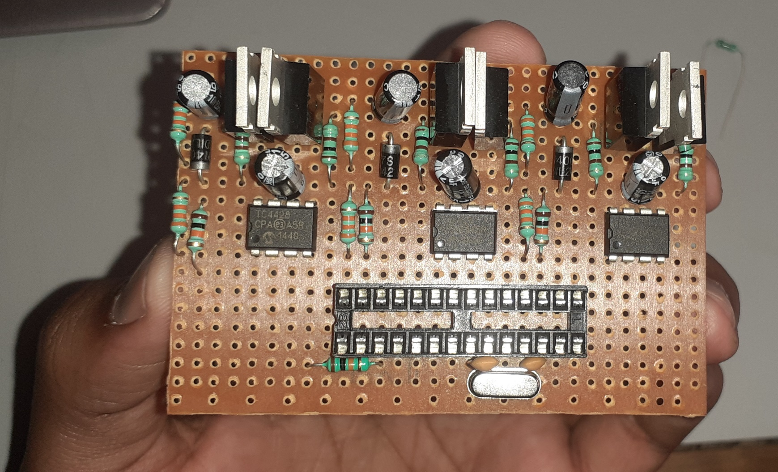
Prototype of my esc
Picture of the BLDC ESC that is being developed by me

Slide 8

Special thanks to my mentors

